Slide 1
RSA ALGORITHM IN CRYPTOGRAPHY
Introduction to cryptography | What is cryptography
Types of Cryptography | What are the types of cryptography
RSA Algorithm | Explain RSA Algorithm & Caluclations
Examples | Show Some examples
Advantages & Disadvantages | Show pros and cons of RSA Algorithm
Applications | where use RSA
By: Zagane Mohammed Mounir
Hamimed Mounir Chemse Eddine

Slide 2

CONTENTS OF THIS Presentation
What are the elements the presentation has
Introduction to cryptography | What is cryptography
Types of Cryptography | What are the types of cryptography
RSA Algorithm | Explain RSA Algorithm & Caluclations
Examples | Show Some examples
Advantages & Disadvantages | Show pros and cons of RSA Algorithm
Applications | where use RSA

Slide 3
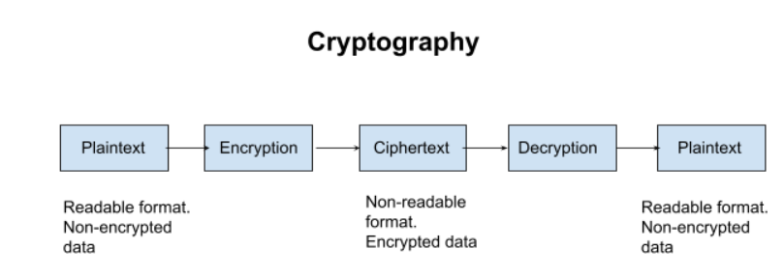
Introduction to Cryptography
Cryptography is the practice and study of techniques for secure communications in the presence of third parties called adversaries.
Cryptography is an Ancient Greek workd which means:
▬ hidden secret in writing ▬

Slide 4
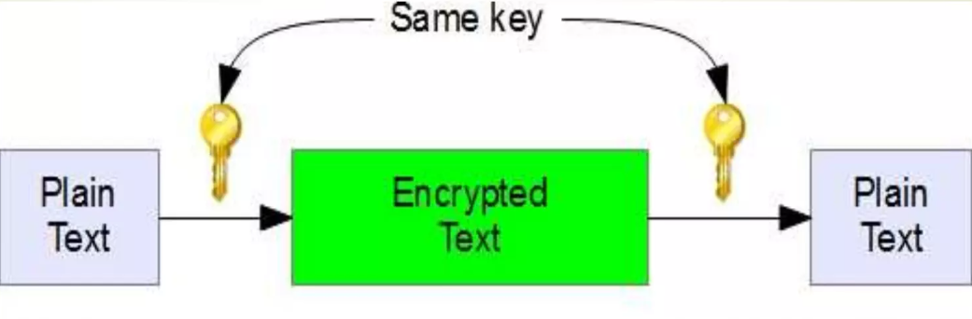
Private Key Cryptography
Private key Cryptography is also known as symmetric – key algorithms.
In this the same Cryptography key is used for both encryption and decryption.

Slide 5
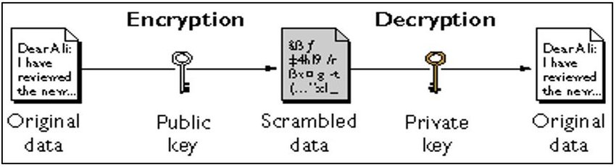
Public Key Cryptography
Public Key Cryptography is also known as Asymmetric key Cryptography.
Here we uses two keys for performing encryption and decryption.

Slide 6
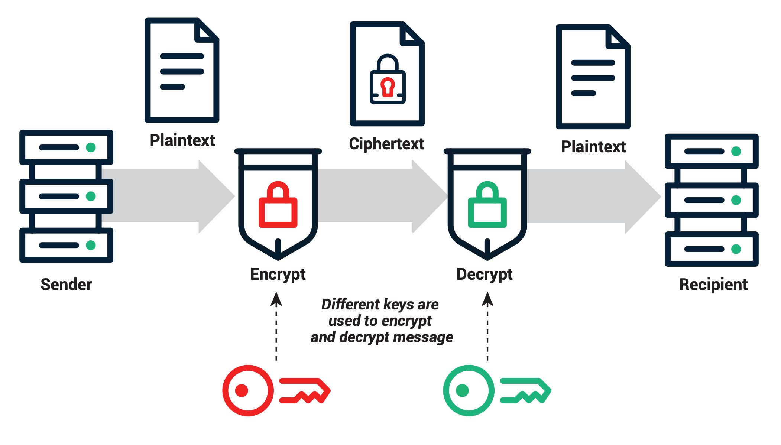

RSA Algorithm
RSA is invented by Rivest, Shamir & Adleman of MIT.
It is most widely used for secure data transmission.
RSA Algorithm is known as Public Key Cryptography.

Slide 7
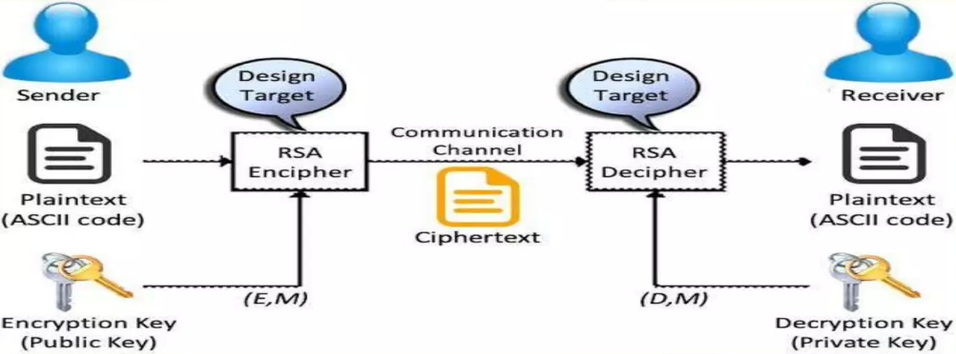
RSA Algorithm
RSA Algorithm consists of following steps:
Key Genration
Encryption
Decryption
Select two prime numbers p & q
Calculate n = p x q
Calculate φ(n) = (p-1) x (q-1)
Choose a small number e, co prime to m , with GCD(φ(n),e) = 1 1<e<φ(n)
Calculate d*e mod φ(n) = 1

Slide 8




DIGITAL SIGNATURE
Select two prime numbers p & q
Calculate n = p x q
Calculate φ(n) = (p-1) x (q-1)
Choose a small number e, co prime to m , with GCD(φ(n),e) = 1 1<e<φ(n)
Calculate d*e mod φ(n) = 1

Slide 9

DIGITAL SIGNATURE
Select two prime numbers p & q
Calculate n = p x q
Calculate φ(n) = (p-1) x (q-1)
Choose a small number e, co prime to m , with GCD(φ(n),e) = 1 1<e<φ(n)
Calculate d*e mod φ(n) = 1

Slide 10
DIGITAL SIGNATURE
Select two prime numbers p & q
Calculate n = p x q
Calculate φ(n) = (p-1) x (q-1)
Choose a small number e, co prime to m , with GCD(φ(n),e) = 1 1<e<φ(n)
Calculate d*e mod φ(n) = 1

Slide 11

DIGITAL SIGNATURE
Select two prime numbers p & q
Calculate n = p x q
Calculate φ(n) = (p-1) x (q-1)
Choose a small number e, co prime to m , with GCD(φ(n),e) = 1 1<e<φ(n)
Calculate d*e mod φ(n) = 1

Slide 12
DIGITAL SIGNATURE
Select two prime numbers p & q
Calculate n = p x q
Calculate φ(n) = (p-1) x (q-1)
Choose a small number e, co prime to m , with GCD(φ(n),e) = 1 1<e<φ(n)
Calculate d*e mod φ(n) = 1

Slide 13

DIGITAL SIGNATURE
Select two prime numbers p & q
Calculate n = p x q
Calculate φ(n) = (p-1) x (q-1)
Choose a small number e, co prime to m , with GCD(φ(n),e) = 1 1<e<φ(n)
Calculate d*e mod φ(n) = 1

Slide 14

DIGITAL SIGNATURE
Select two prime numbers p & q
Calculate n = p x q
Calculate φ(n) = (p-1) x (q-1)
Choose a small number e, co prime to m , with GCD(φ(n),e) = 1 1<e<φ(n)
Calculate d*e mod φ(n) = 1

Slide 15
DIGITAL SIGNATURE
Select two prime numbers p & q
Calculate n = p x q
Calculate φ(n) = (p-1) x (q-1)
Choose a small number e, co prime to m , with GCD(φ(n),e) = 1 1<e<φ(n)
Calculate d*e mod φ(n) = 1

Slide 16

DIGITAL SIGNATURE
Select two prime numbers p & q
Calculate n = p x q
Calculate φ(n) = (p-1) x (q-1)
Choose a small number e, co prime to m , with GCD(φ(n),e) = 1 1<e<φ(n)
Calculate d*e mod φ(n) = 1

Slide 17


Key generation
Select two prime numbers p & q
Calculate n = p x q
Calculate φ(n) = (p-1) x (q-1)
Choose a small number e, co prime to m , with GCD(φ(n),e) = 1 1<e<φ(n)
Calculate d*e mod φ(n) = 1

Slide 18
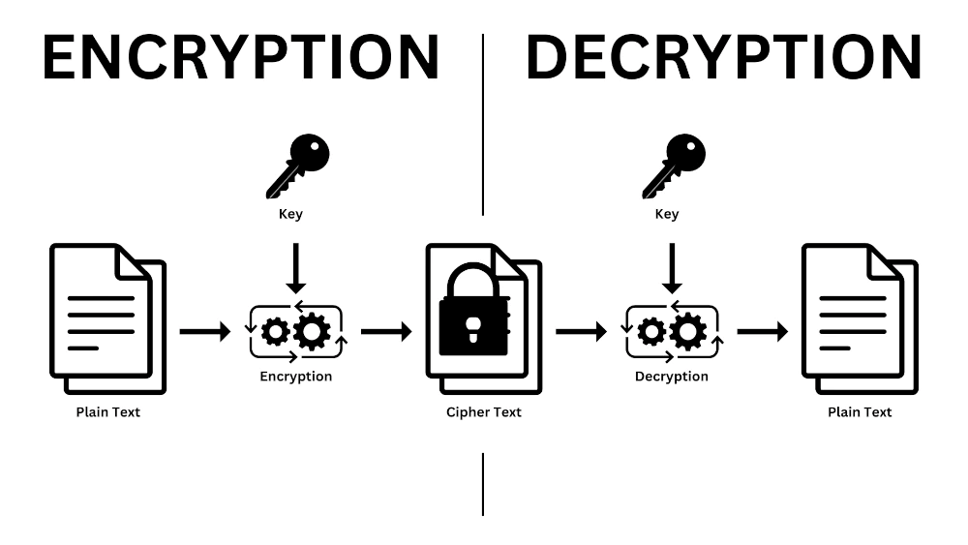


Encryption
Plaintext, M < n
$M^{e} mod n=C$
Decryption
Ciphertext, C
$C^{d} mod n=M$

Slide 19

RSA Algorithm Example
Let p = 3, q = 11
n = p x q
n = 3 x 11 = 33
Φ(n) = (p-1) x (q-1) = 20
Let e = 7 such that 1 < 7 < 20
GCD (7,20) = 1
ed = 1 mod 20
7 x d mod 20 =1
7 x 3 mod 20 = 1
Here d = 3

Slide 20

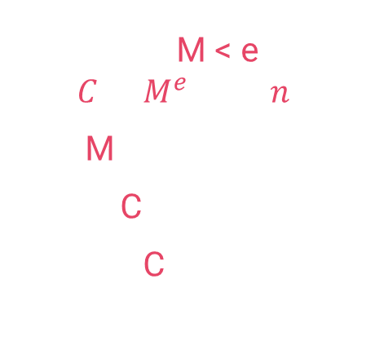
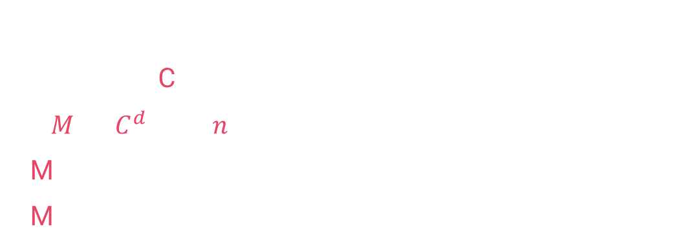
Encryption
Let p = 3, q = 11
n = p x q
n = 3 x 11 = 33
Φ(n) = (p-1) x (q-1) = 20
Let e = 7 such that 1 < 7 < 20
GCD (7,20) = 1
ed = 1 mod 20
7 x d mod 20 =1
7 x 3 mod 20 = 1
Here d = 3
Plaintext, M < e
$$C=M^{e} mod n$$
Let M = 31
Then, C =${ 3}^{17} mod 33$
We get C = 4
Decryption
Ciphertext, C
$M= C^{d} mod n$
M = $4^{3} mod 33$
M = 31

Slide 21
Advantages
Very fast, very simple encryption and verification.
Easy to implement than Elliptical Curve Cryptography.
Easier to Understand.
Widely deployed, better industry support.
Disadvantages
Very slow key Generation.
Slow decryption, which is slightly tricky to implement securely.

Slide 22

We know we did well Thanks

